Slide 1
Introduction to Cyber Security
COMP3134 Week 6

Slide 2
Overview
Objective
Web server hacking
Main Teaching Points
An application is hosted on a server
Application may be gateway to server
Learning Outcome(s)
Implement various tactics to attack a network or application

Slide 3
Web Server Hacking

Slide 4
HTTP: HyperText Transport Protocol
Has vulnerabilities that developers must understand
Hackers exploit these vulnerabilities
Web servers are most targeted servers
Simple, stateless protocol (port 80)
Does not need persistent connection for communication logic
Transaction = request from client => response from server
Stateful protocol
Related commands treated as single interaction
Server maintains state with client during successive commands until interaction terminated
Session = sequence of transmitted and executed commands

Slide 5
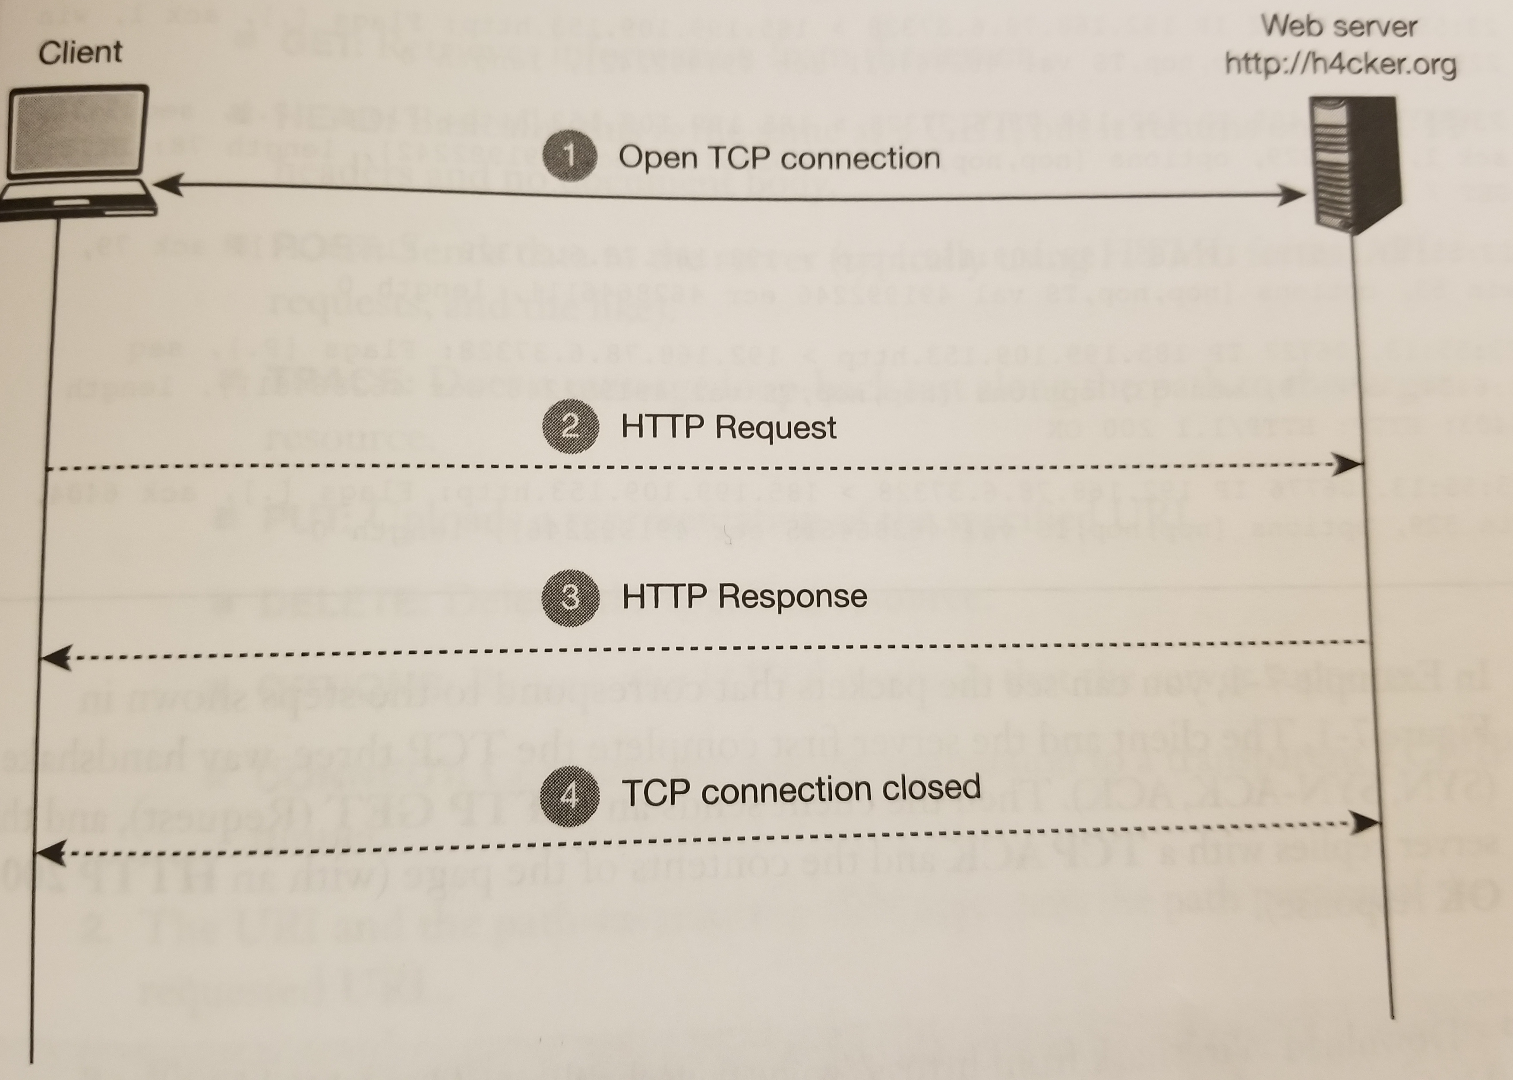
General Stages for HTTP

Slide 6
TCP Flags Revisited
S
Synchronization
1st step in attempting to establish connection
P
Push
Stop buffering and send data to application layer
A
Acknowledgement
Connection successful and packet received

Slide 7
TCP Flags Revisited
R
Reset
Abrupt termination of connection
U
Urgent
Packet marked as priority. Send right away
F
Finish
Termination of connection when transfer comple

Slide 8
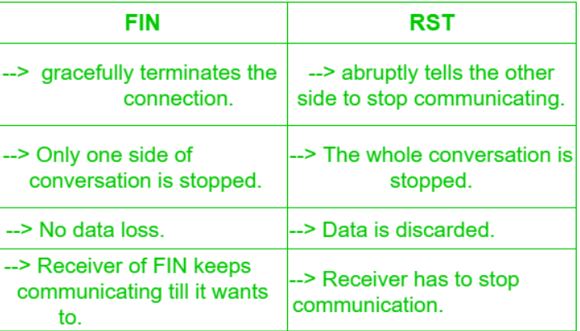
Finish vs Reset

Slide 9
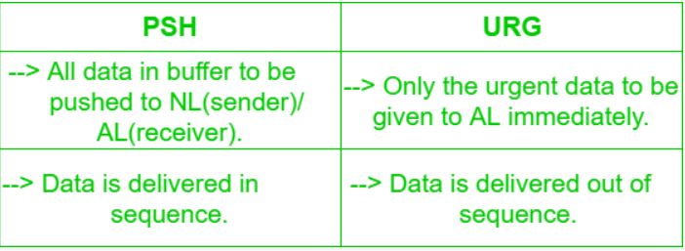
Push vs Urgent

Slide 10
HTTP: Request Methods
GET
HEAD
POST
TRACE
PUT
DELETE
OPTIONS
CONNECT

Slide 11
HTTP: Status Codes
100s
informational
200s
Successful transactions
300s
http redirections
400s
Client errors
500s
Server errors

Slide 12
HTTP: HyperText Transport Protocol
Components of the URL
Scheme
protocol
domain
Sub-domain second-level domain top-level domain
my gblearn com
Path
Folder and/or file declaration after the domain
Hash
#
Query string
?

Slide 13
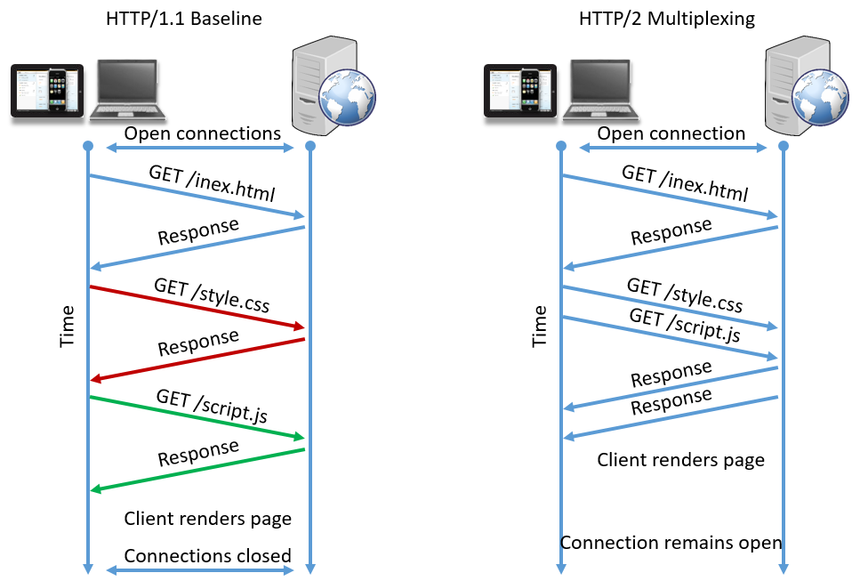
HTTP: 1.0 vs 2.0

Slide 14
HTTP: Proxies
Definition
Could server as client or server
Make requests to web servers on behalf of other clients
Provide support for caching
Comparison
Someone else representing you
Lawyer

Slide 15
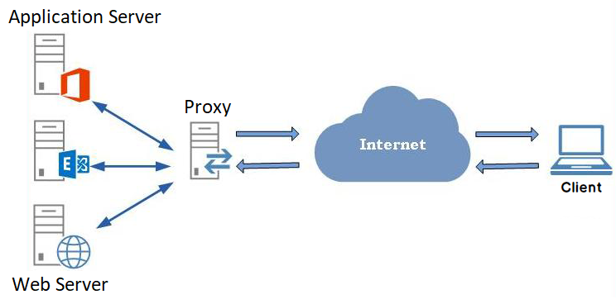
HTTP: Proxy

Slide 16
Web Server Hacking
Now we have some knowledge => more to intermediate step
Listening/ monitoring / observation
Attacker must determine
what is open, vulnerable => best chance of attack

Slide 17
Web Server Hacking Attack Techniques
Scanning Web Servers
Tools
Nmap
Banner Grabbing and Enumeration
Definition
Identify server distribution and version
Tool
Telnet
Netcat
whatweb

Slide 18
Web Server Hacking Attack Techniques
Web Server Vulnerability Identification
Definition
Identify vulnerabilities or items that are unpactched
Tool
OpenVAS
Online SaS Tools
Intruder
https://intruder.io/
* SaS = Service as Software

Slide 19
Scanning Web Servers
Cannot attack what doesn’t exist
Get target IP address or target range of IP addresses
Look for web services
http usually run on 80, 443
Other ports may be open
Use Nmap to scan for ports

Slide 20
Banner Grabbing and Enumeration
Fingerprinting
Information collected about a remote computing device for the purpose of identification
Demo
Using telnet
Using netcat
Using whatweb
Use site-ripper to extract site to localhost
https://websitedownloader.io/ (paid service)

Slide 21
Web Server Vulnerability Identification
After fingerprinting => search for vulnerabilities
Look-up such vulnerabilities of known sites
https://www.exploit-db.com/

Slide 22
Terms to Know
HTTP
Session
Request methods
Status codes
1.0 vs 2.0
Stateless, stateful
Components of URL
Proxies
Scanning Web Servers
Banner Grabbing and Enumeration
Web Server Vulnerability Identification

Slide 23
Resources
Websites
Banner Grabbing
https://www.peerlyst.com/posts/infosec-basics-definition-of-and-understanding-banner-grabbing-gina-robertson
Videos
Proxy & Reserve Proxy
https://www.youtube.com/watch?v=ozhe__GdWC8

